Slide 1
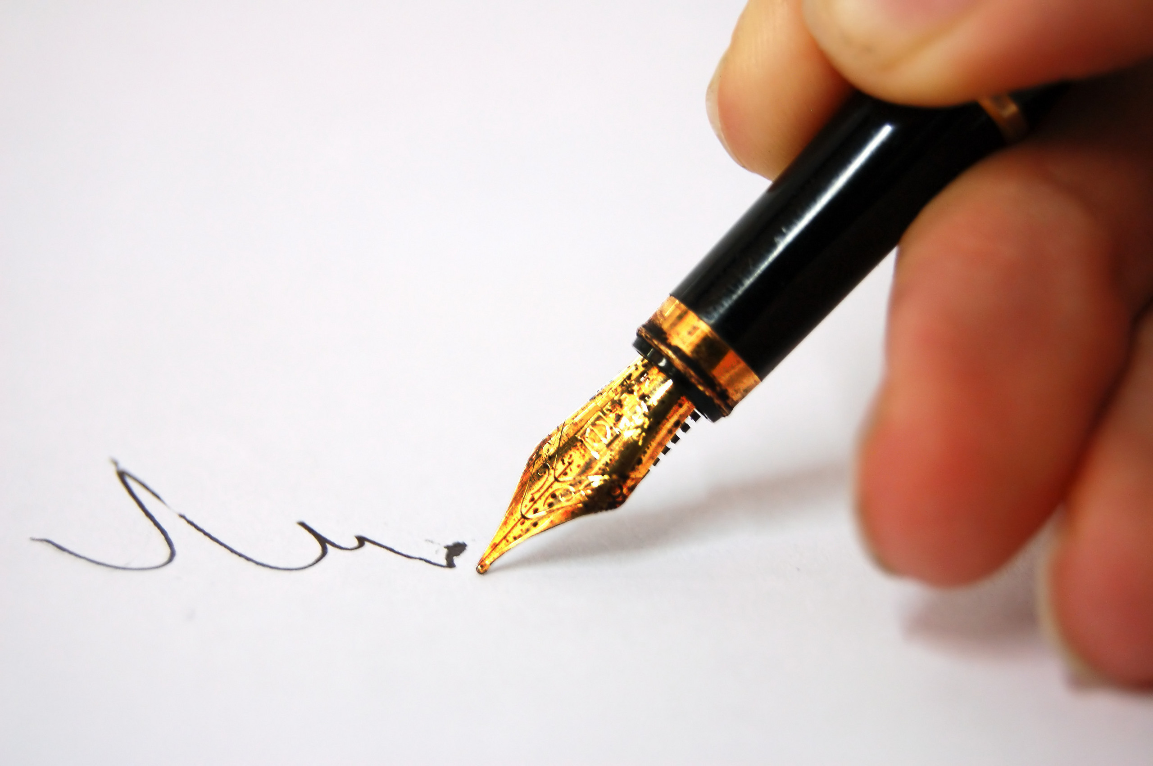
THE HABITS OF LITERACY
Note:
In this session, you will need something to write with and on – preferably pen and paper
Geoff Barton
Festival of Education 2014
21 June 2014
geoffbarton.co.uk/teacher_resources
(Number 129)
Twitter: @RealGeoffBarton
Geoff Barton ⎜ Festival of Education ⎜ 21 June 2014
Download this presentation free at: geoffbarton.co.uk/teacher_resources (Number 129) ⎜
Twitter: @RealGeoffBarton

Slide 2
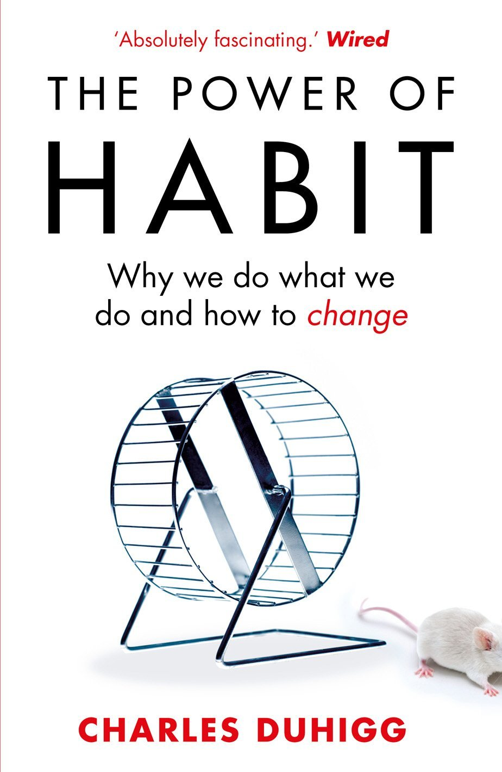
‘More than 40% of the actions people perform each day aren’t decisions but habits …’

Slide 3
‘Habits, scientists say, emerge because the brain is constantly looking for ways to save effort’

Slide 4
‘That’s why signing kids up for piano lessons or sports is so important. It has nothing to do with creating a good musician or a five year-old soccer star’

Slide 5
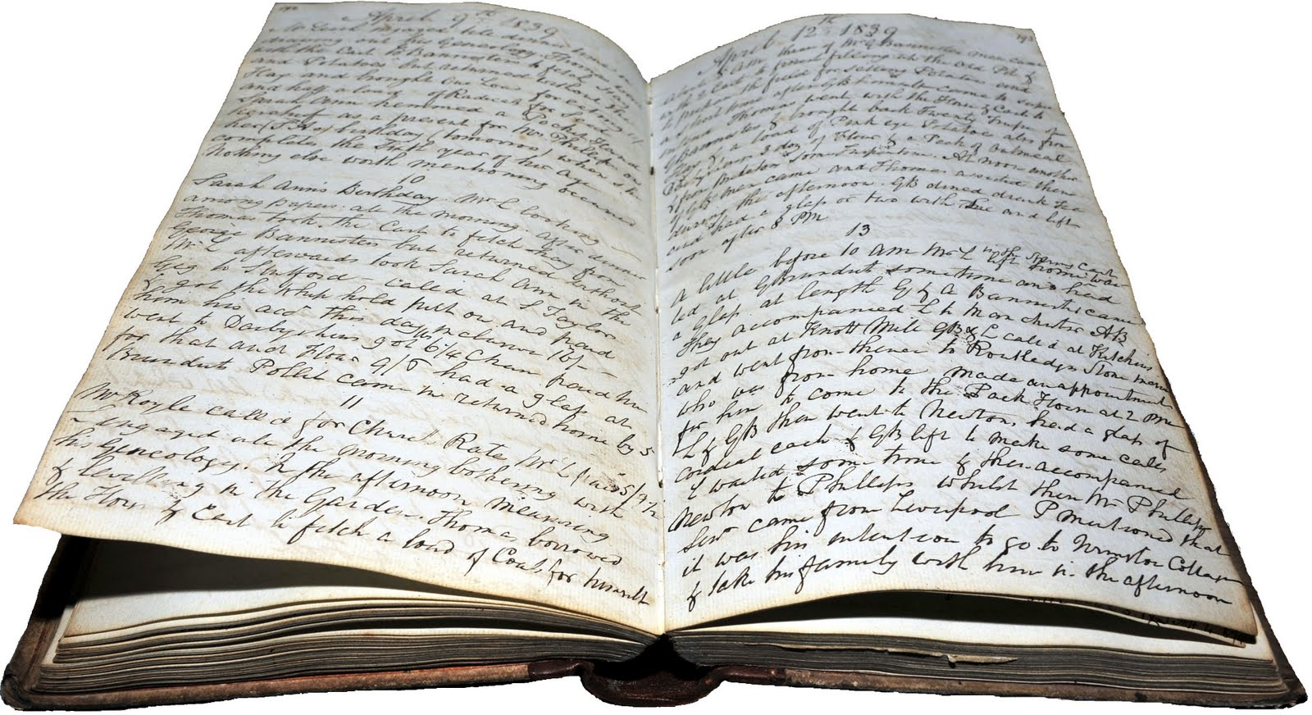
The Story So Far …

Slide 7
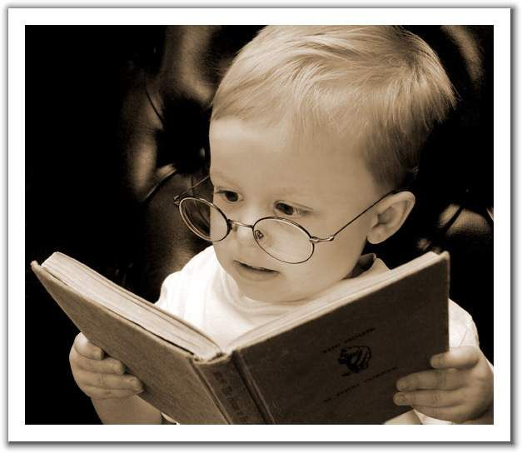

Slide 8
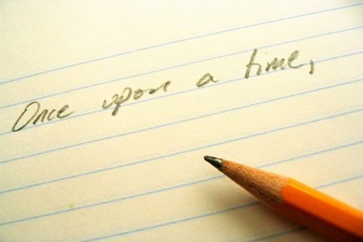

Slide 9
WORD RICH
&
WORD POOR

Slide 10
1: The Habits of Talk:
Are public schools better than state schools?
Notes:
Necessary; accommodation; February;

Slide 11
2: The Habits of Spelling
Notes:
Necessary, accommodation, humorous

Slide 12
3: The Habits of Reading

Slide 13
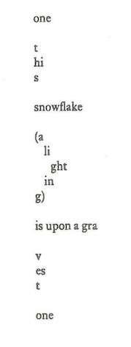
What’s this all about …?

Slide 14
4: The Habits of Writing (a)
Dictation
Notes:
It’s really beautiful out there; in here, however, it’s quite claustrophobic

Slide 15
4: The Habits of Writing (b)
Describe your journey here today
Notes:
It’s really beautiful out there; in here, however, it’s quite claustrophobic

Slide 16
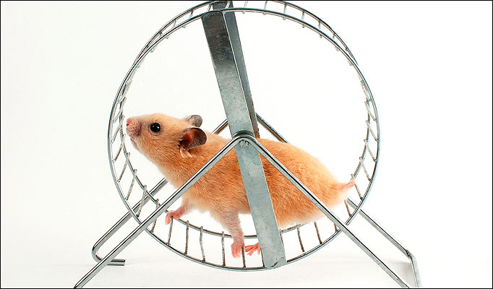

Slide 17
Habit 1:
RESILIENCE

Slide 19
Craig Raine:
‘A Martian Sends a Postcard Home’

Slide 20
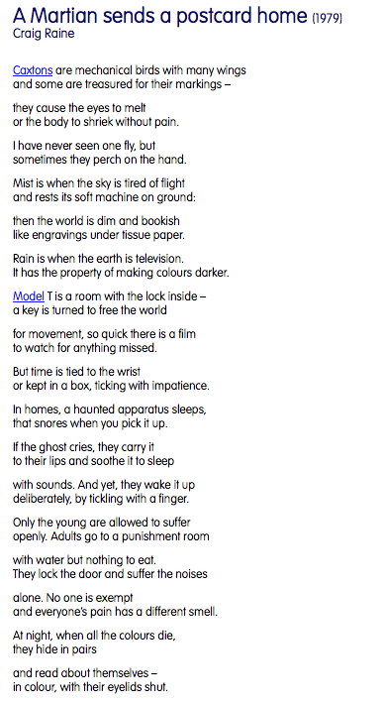

Slide 21
Caxtons are mechanical birds with many wings and some are treasured for their markings-- they cause the eyes to melt or the body to shriek without pain. I have never seen one fly, but sometimes they perch on the hand.
Notes:
Modelling inquiry; the pleasure of not knowing – like cross words

Slide 22
Habit 2:
PLAYFULNESS

Slide 23
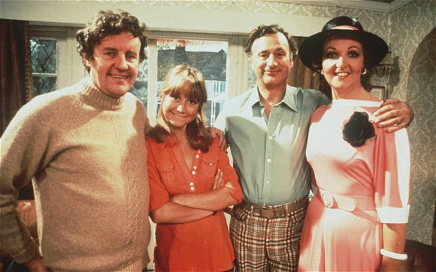

Slide 24
Habit 3:
PRIOR KNOWLEDGE:

Slide 25
Talk:
Are public schools better than state schools?
Notes:
Necessary; accommodation; February;

Slide 26
What if Jane Austen was rewritten by Dylan Thomas?
Notes:
Necessary; accommodation; February;

Slide 27
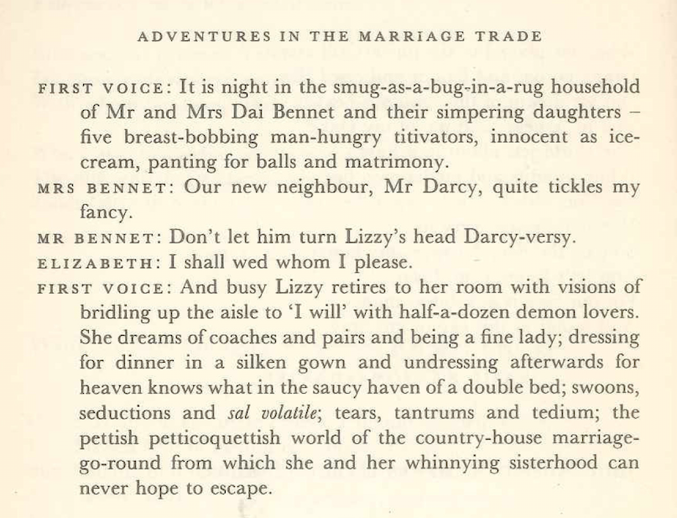

Slide 28
Habit 4: Writing Well
SELF-REGULATION
LEXICAL & SYNTACTIC VARIETY
Notes:
It’s really beautiful out there; in here, however, it’s quite claustrophobic
Necessary; accommodation; humorous

Slide 29
NECESSARY
ACCOMMODATION
HUMOROUS
Notes:
It’s really beautiful out there; in here, however, it’s quite claustrophobic

Slide 30
4: Writing
Describe your journey here today
Notes:
It’s really beautiful out there; in here, however, it’s quite claustrophobic

Slide 31
Write a biography of a famous writer. How will it begin?
Notes:
It’s really beautiful out there; in here, however, it’s quite claustrophobic

Slide 32
The Life of Charles Dickens
Chapter 1
CHARLES DICKENS, the most popular novelist of the century, and one of the greatest humorists that England has produced, was born at Lanport, in Portsea, on Friday, the seventh of February, 1812.
His father, John Dickens, a clerk in the navy pay-office, was at this time stationed in the Portsmouth Dockyard. He had made acquaintance with the lady, Elizabeth Barrow, who became afterwards his wife, through her elder brother, Thomas Barrow, also engaged on the establishment at Somerset House, and she bore him in all a family of eight children, of whom two died in infancy. The eldest, Fanny (born 1810), was followed by Charles (entered in the baptismal register of Portsea as Charles John Huffham, though on the very rare occasions when he subscribed that name he wrote Huffam); by another son, named Alfred, who died in childhood; by Letitia (born 1816); by another daughter, Harriet, who died also in childhood; by Frederick (born 1820); by Alfred Lamert (born 1822); and by Augustus (born 1827).

Slide 33
DICKENS
CHARLES DICKENS was dead. He lay on a narrow green sofa – but there was room enough for him, so spare had he become – in the dining room of Gad’s Hill Place. He had died in the house which he had first seen as a small boy and which his father had pointed out to him as a suitable object of his ambitions; so great was his father’s hold upon his life that, forty years later, he had bought it. Now he had gone. It was customary to close the blinds and curtains, thus enshrouding the corpse in darkness before its last journey to the tomb; but in the dining room of Gad’s Hill the curtains were pulled apart and on this June day the bright sunshine streamed in, glittering on the large mirrors around the room. The family beside him knew how he enjoyed the light, how he needed the light; and they understood, too, that none of the conventional sombreness of the late Victorian period – the year was 1870 – had ever touched him.
All the lines and wrinkles which marked the passage of his life were new erased in the stillness of death. He was not old – he died in his fifty-eighth year – but there had been signs of premature ageing on a visage so marked and worn; he had acquired, it was said, a “sarcastic look”. But now all that was gone and his daughter, Katey, who watched him as he lay dead, noticed how there once more emerged upon his face “beauty and pathos”.

Slide 34
Describe your holiday
Notes:
It’s really beautiful out there; in here, however, it’s quite claustrophobic

Slide 35
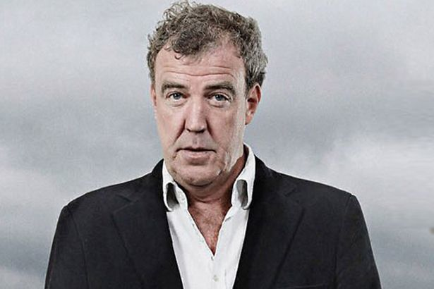
Notes:
It’s really beautiful out there; in here, however, it’s quite claustrophobic

Slide 36
For your next holiday, why don’t you take all your money and put it on the fire? Then stand in a fridge for a week, beating your children with a baseball bat until their arms and legs break. And then, after you’ve eaten some melted cheese, dislocate your shoulder. If all of this appeals then you are probably one of the 1.3 million British people …
… who go on a skiing holiday at this time of year.
Notes:
It’s really beautiful out there; in here, however, it’s quite claustrophobic

Slide 37
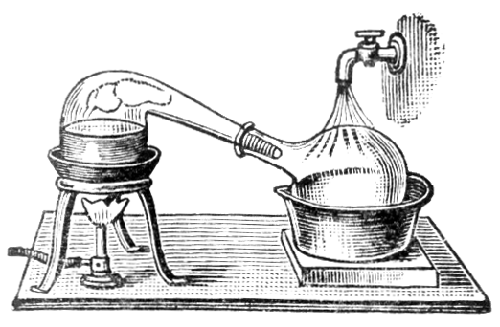
The habits of literacy distilled
Notes:
It’s really beautiful out there; in here, however, it’s quite claustrophobic

Slide 38
1 Remember the Matthew Effect
2 Build and link to prior knowledge
3 Know and teach the language of power – especially of depersonalisation
4 Demonstrate the process of writing
5 Naturalise reading
(Bonus: playfulness is allowed in classrooms)
Notes:
It’s really beautiful out there; in here, however, it’s quite claustrophobic

Slide 40
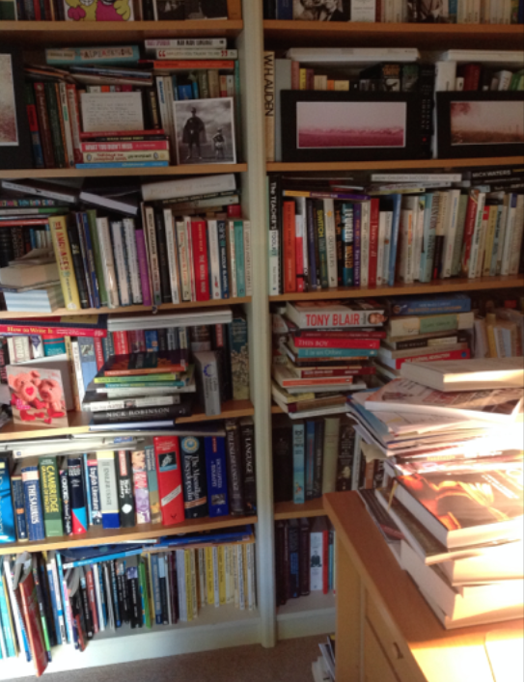

Slide 41
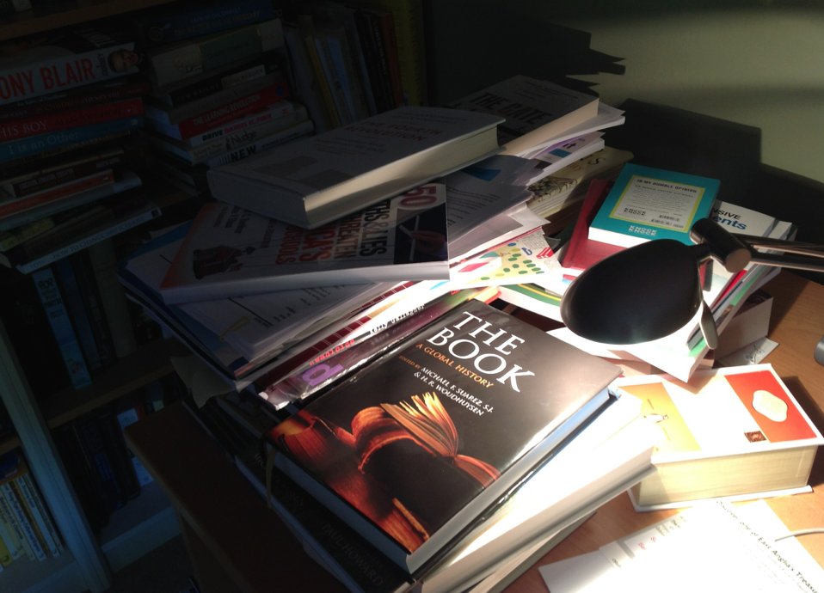

Slide 42
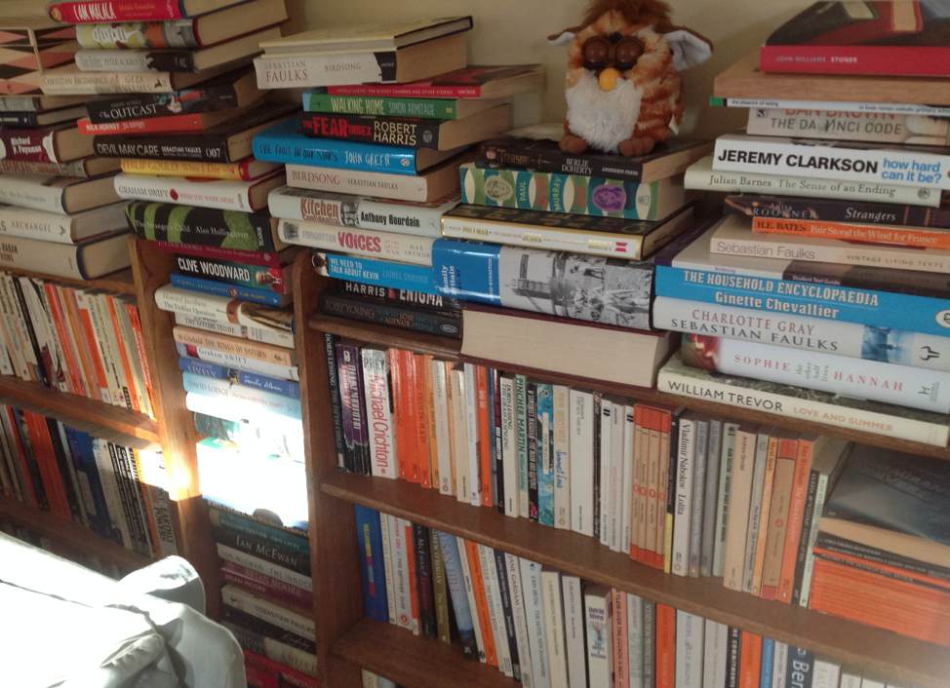

Slide 43
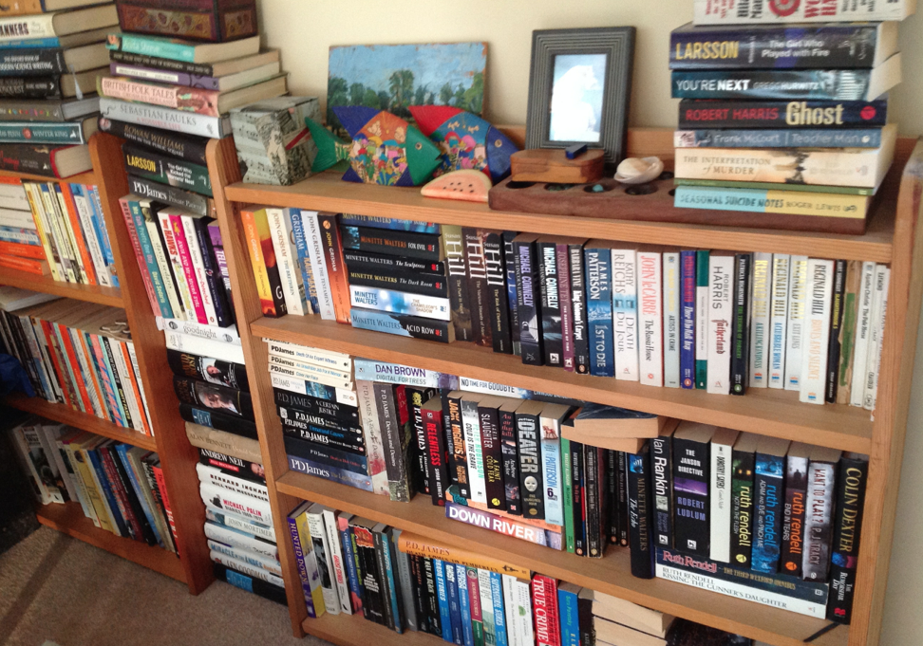

Slide 44
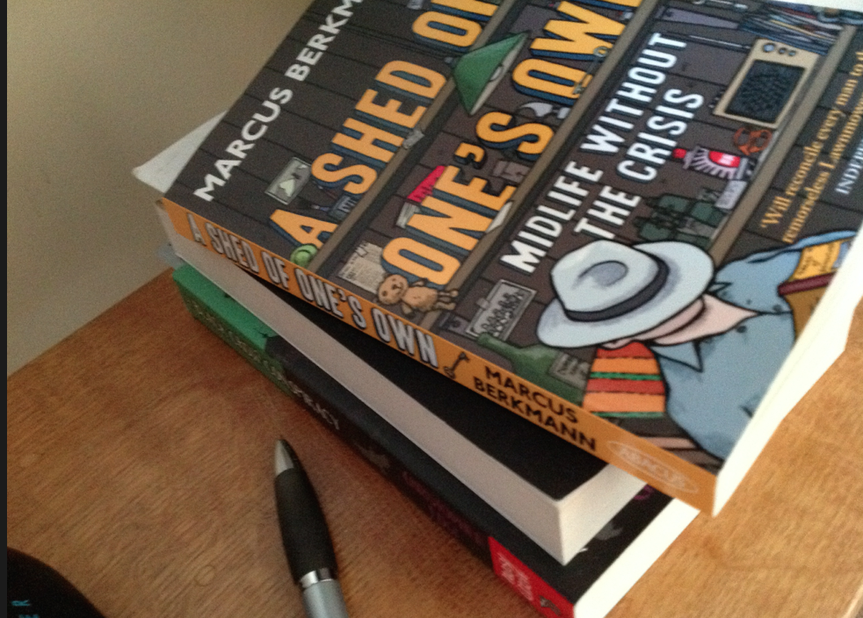

Slide 45
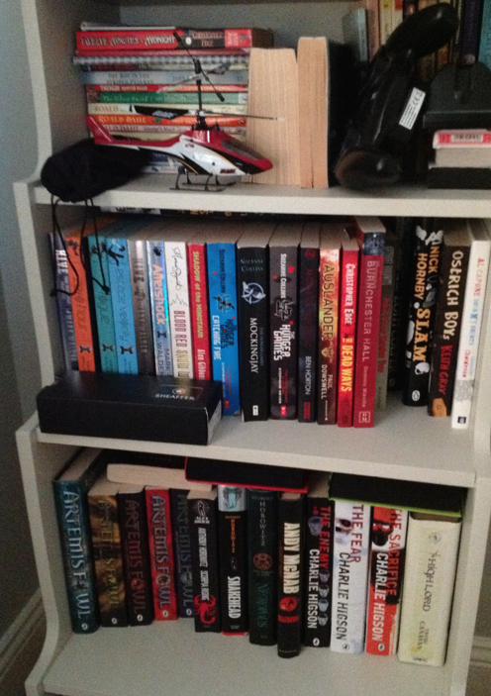

Slide 46
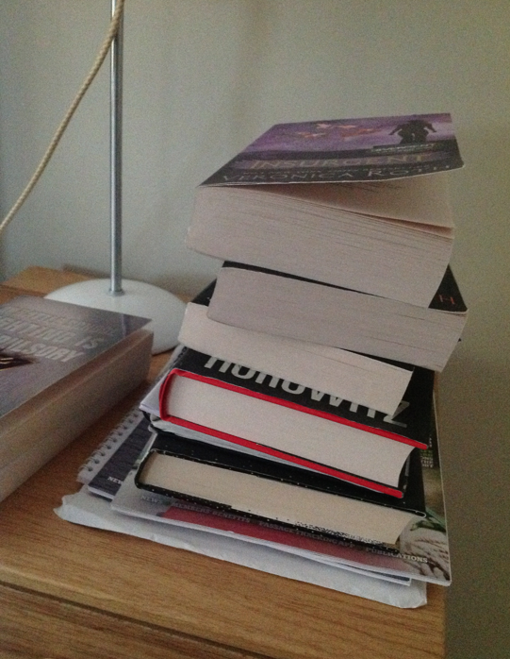

Slide 47
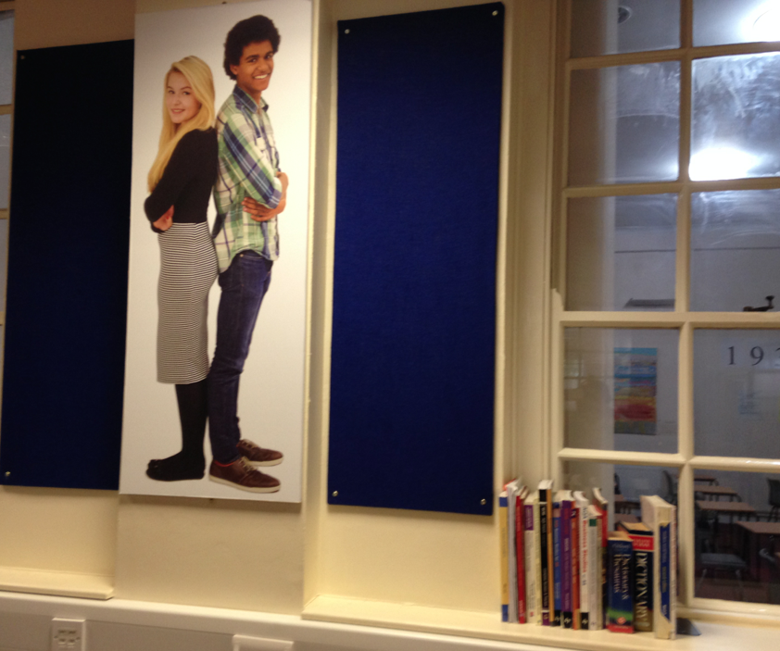

Slide 48
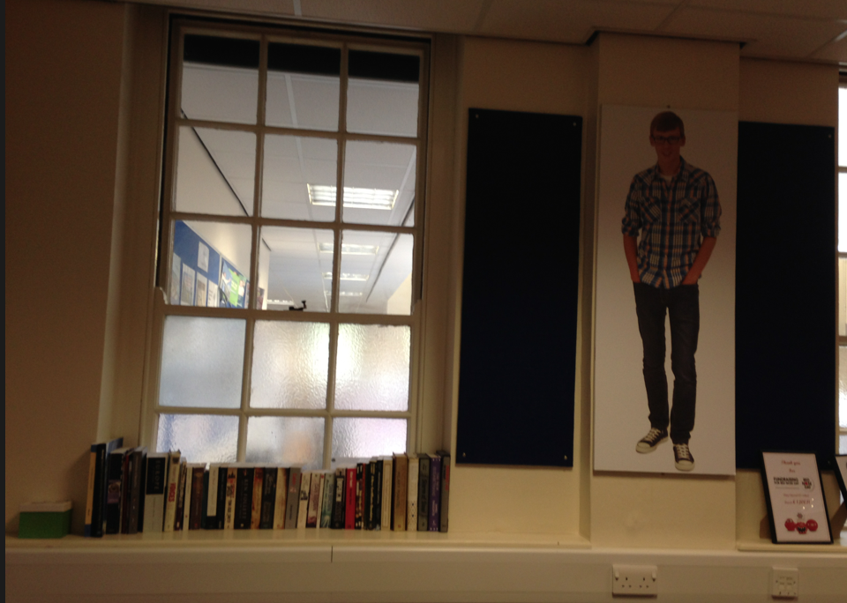

Slide 49
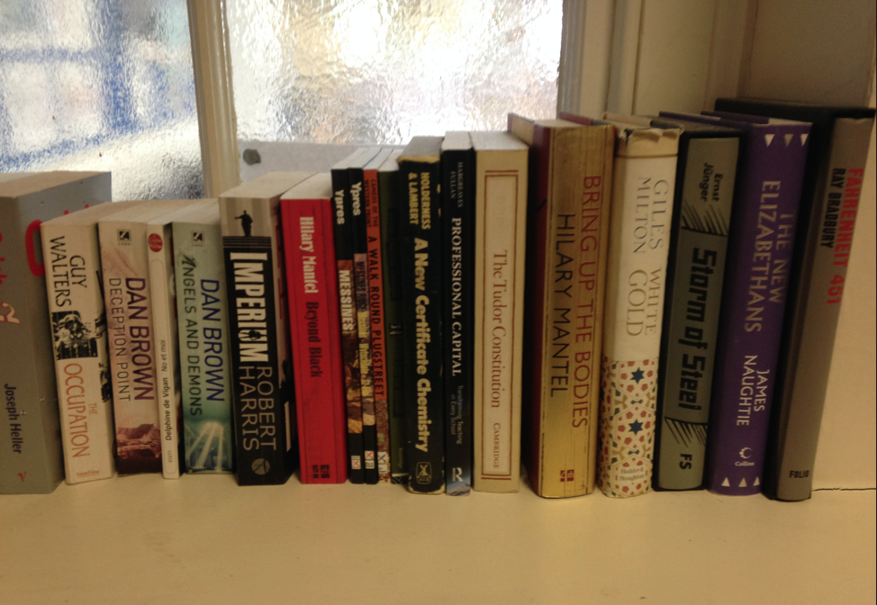

Slide 50
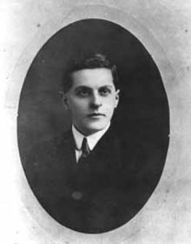
The limits of my language mean the limits of my world
Notes:
It’s really beautiful out there; in here, however, it’s quite claustrophobic

Slide 51
THE HABITS OF LITERACY
Geoff Barton
Festival of Education 2014
21 June 2014
geoffbarton.co.uk/teacher_resources
(Number 129)
Twitter: @RealGeoffBarton
Geoff Barton ⎜ Festival of Education ⎜ 21 June 2014
Download this presentation free at: geoffbarton.co.uk/teacher_resources (Number 129) ⎜
Twitter: @RealGeoffBarton

Slide 52
PS:
Read the right books*
*Perfect gift for family & friends
* Come and say hello at the Routledge stand from 13:10

